Slide 1


Analyzing NFL Wide Receivers vs Tight Ends: What Drives Success?
Patrick M, Patrick W, Ihor, Andreas, Justin

Slide 2
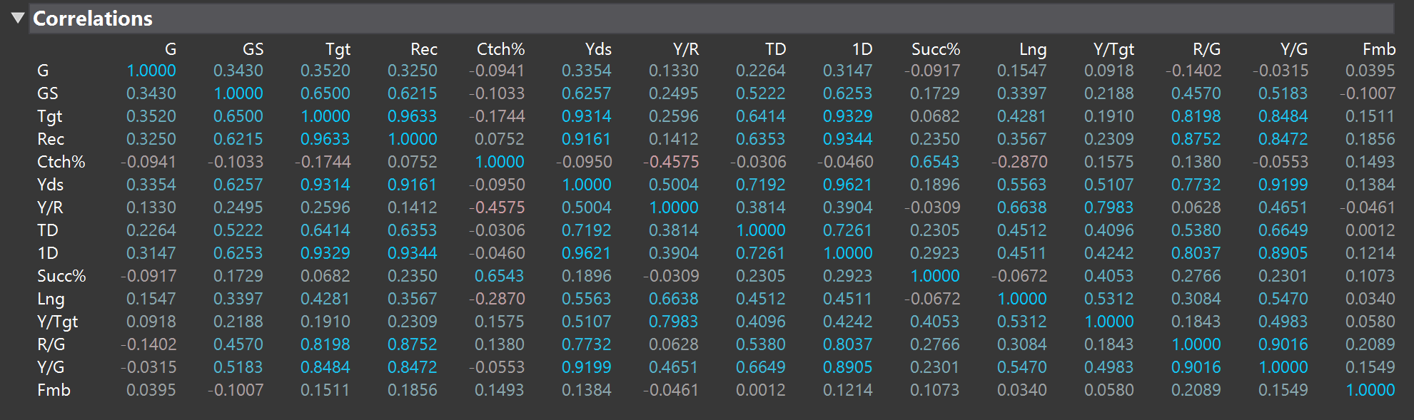

Which Relationship Stands Out in the Data? (multivariant)
Interpretation:
The relationship that stands out most is total yards. Total yards is strongly connected to first downs, receptions, targets, and yards per game. So the main takeaway is that receiving success is not just about position. It is more about how involved the player is in the offense
Hypothesis:
H0: No strong relationship exist among Receiving metrics
H1: Production and efficiency variables are strongly related to receiving metrics
Strongest practical relationships with total yards
Yds with First Downs r = .9621
Yds with Receptions r = .9161
Yds with Targets r = .9314
Yds with Yards/Game r = .9199

Slide 3
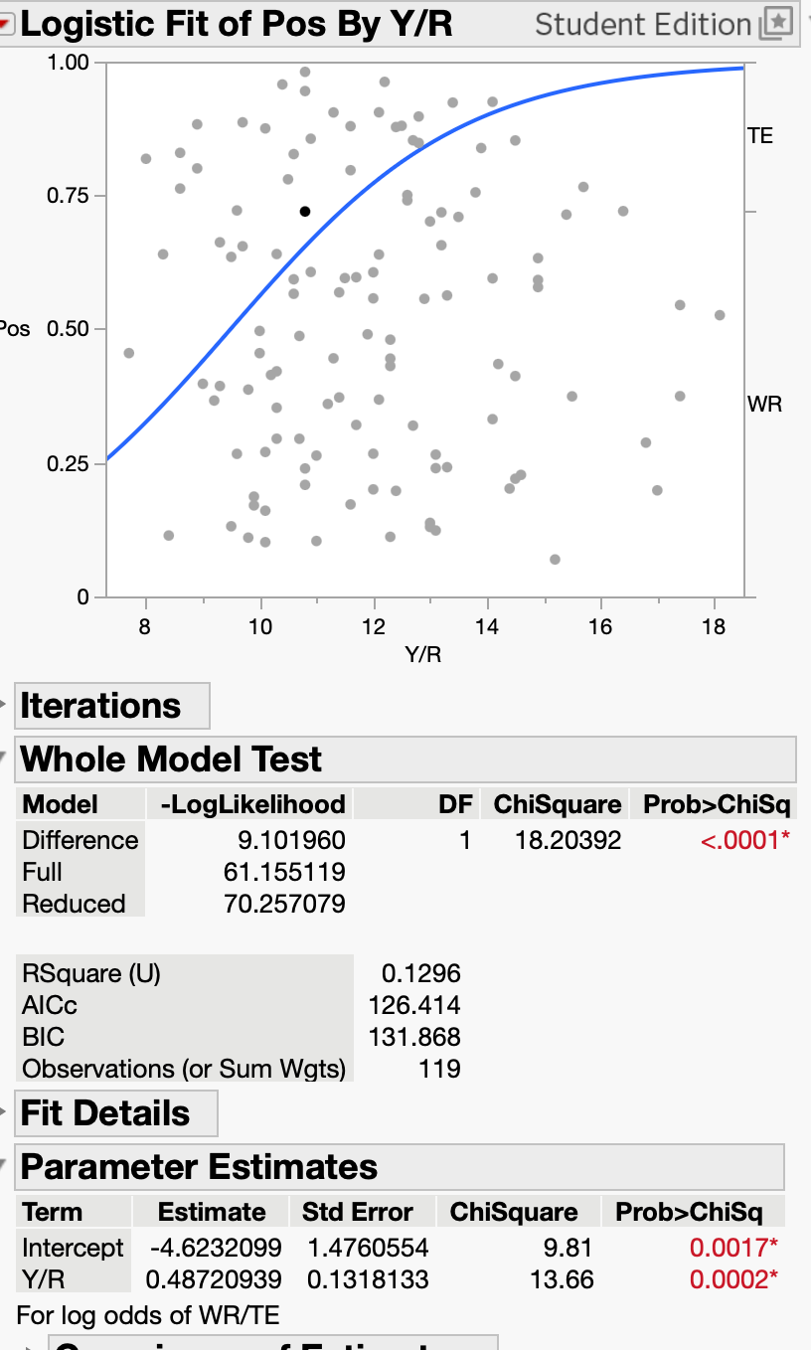
Do Wide Receivers and Tight Ends differ in Yards Per Reception?
Interpretation
Yards per reception has a statistically significant relationship with position, meaning WRs and TEs do show some differences in how many yards they gain per catch. This makes sense because WRs are usually used more as downfield receiving threats, while TEs are often used in shorter routes, middle-field routes, and first-down situations. However, the R² value of about 0.13 shows that yards per reception only explains part of the difference. There is still overlap between the two positions, especially because modern TEs are becoming more involved in the passing game.
Whole Model Test
p < .0001
Y/R Coefficient
p = .0002
R^2 (U)
= .1296

Slide 4

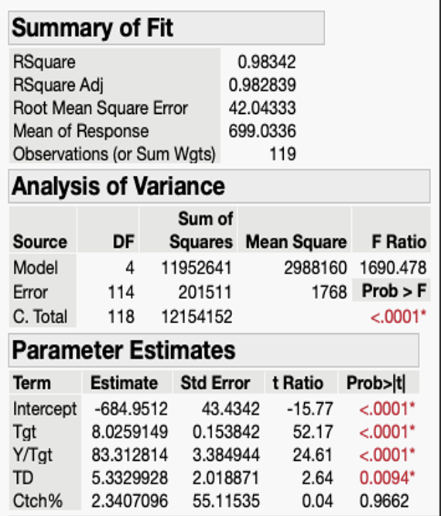
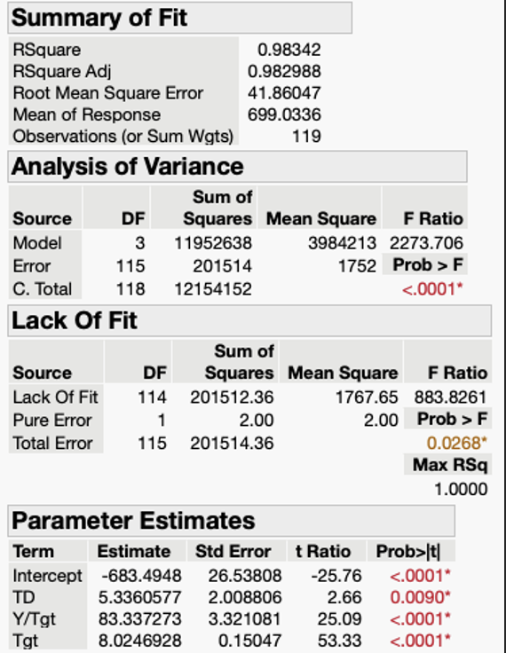
Multiple Linear Regression (MLR)
Initial Model:
Final Model:

Slide 5


Regression Analysis
The overall estimation of the final model is:
Ŷ = - 684 + 5x1 + 83x2 + 8.02x3
where x1 is the numbers of touchdowns (TD), x2 is the number of yards per target, and x3 is the numbers of targets made by the players.
The results suggest that:
Targets (Tgt) is a key driver of receiving yards, highlighting the importance of opportunity and usage.
Yards per Target (Y/Tgt) captures efficiency, showing that more productive targets lead to greater overall output.
Touchdowns (TD) also contribute positively, reflecting a player’s ability to generate scoring plays, which are often associated with higher yardage totals.

Slide 6
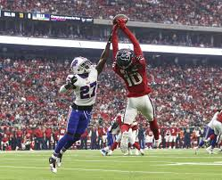
Conclusion
WRs and TEs differ significantly (p < .001), but effect is modest (R² ≈ 0.13)
Production is driven by volume, not efficiency
Strongest relationships:
  Yards with Targets, Receptions, First Downs (r > .90)
MLR confirms targets, Y/Tgt, and TDs are key drivers of yards
Final Takeaway:
Differences are driven more by usage than efficiency, regardless of position

